Slide 1
Project: TOURISM
Name: CH.V.DINESH REDDY(11710602)
SHAIK MOIN(11710587)
VIPIN CHOWDARY(11710603)
Section: K17UX (G1)

Slide 2
WEB DESIGN
We are introducing a new website for people regarding tourism.
This website is very easy to use by the user and helpful.
For making this web design we have used HTML,CSS & JAVA SCRIPT.
We can book our tickets and we can see the places before visiting the places.
Any body can contact us through this website.

Slide 3
HTML :- Hypertext Mark up Language, a standardized system for tagging text files to achieve font, colour, graphic, and hyperlink effects on World Wide Web pages.
CSS :- CSS stands for Cascading Style Sheets. CSS describes how HTML elements are to be displayed on screen, paper, or in other media. CSS saves a lot of work. It can control the layout of multiple web pages all at once. External stylesheets are stored in CSS files.
JAVA SCRIPT :- An object-oriented computer programming language commonly used to create interactive effects within web browsers.

Slide 4
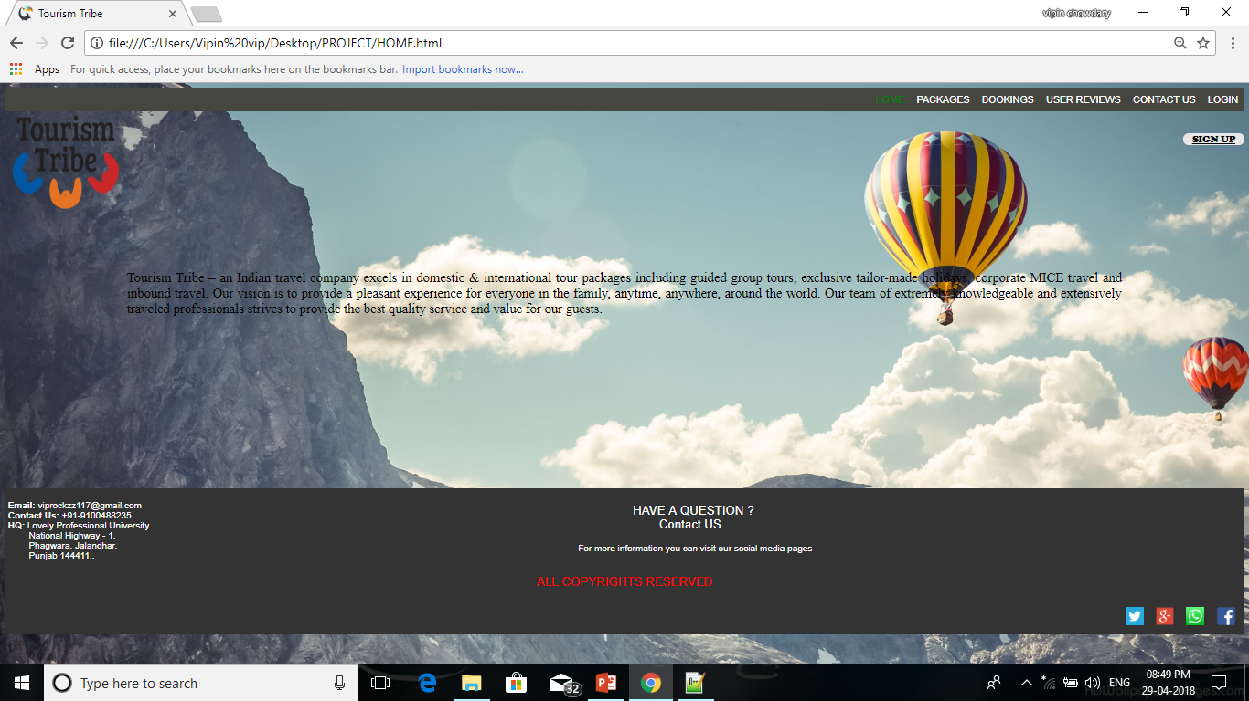
HOME PAGE
Home page tells that what does this web site can provide you.
By using HTML & CSS we made this page.
This home page providing login, sign-up, packages, booking, reviews & contact us.

Slide 5
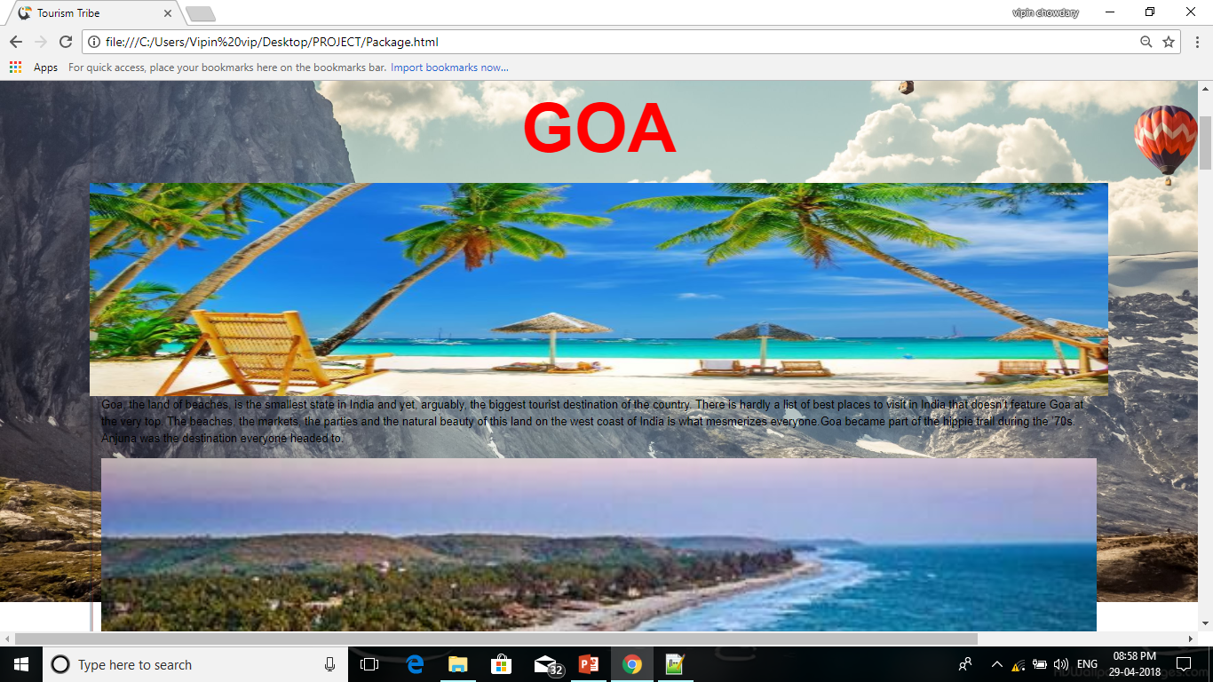
PACKAGES
Packages showing the tourist places to visit.
We have used HTML and CSS to make this page.
This page contains photos and videos of that places to look.

Slide 6
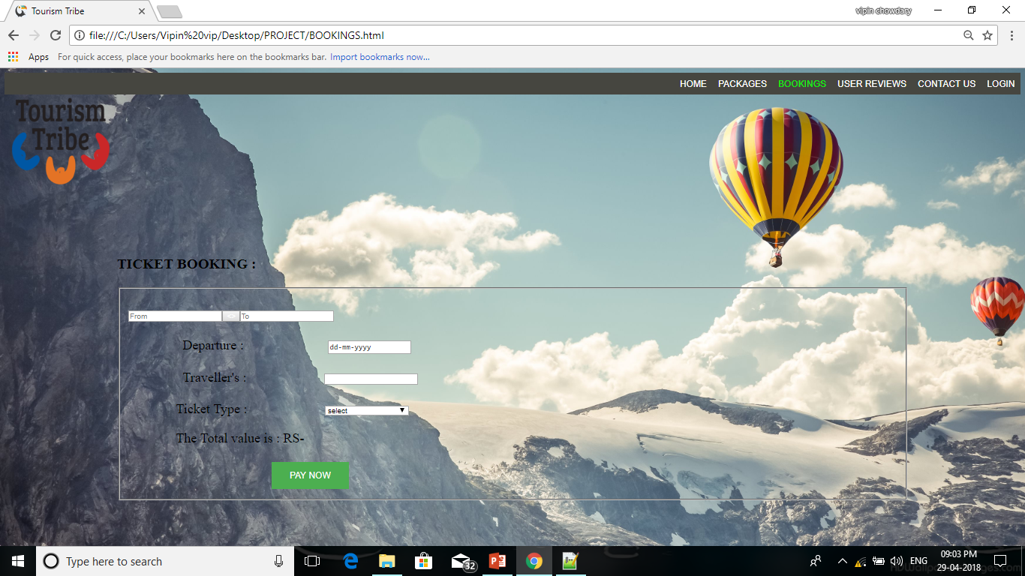
BOOKINGS
We can book the tickets for tours in this page.
We have used HTML,CSS and JAVA SCRIPT to make page.
By using java script it has a good looking.

Slide 7
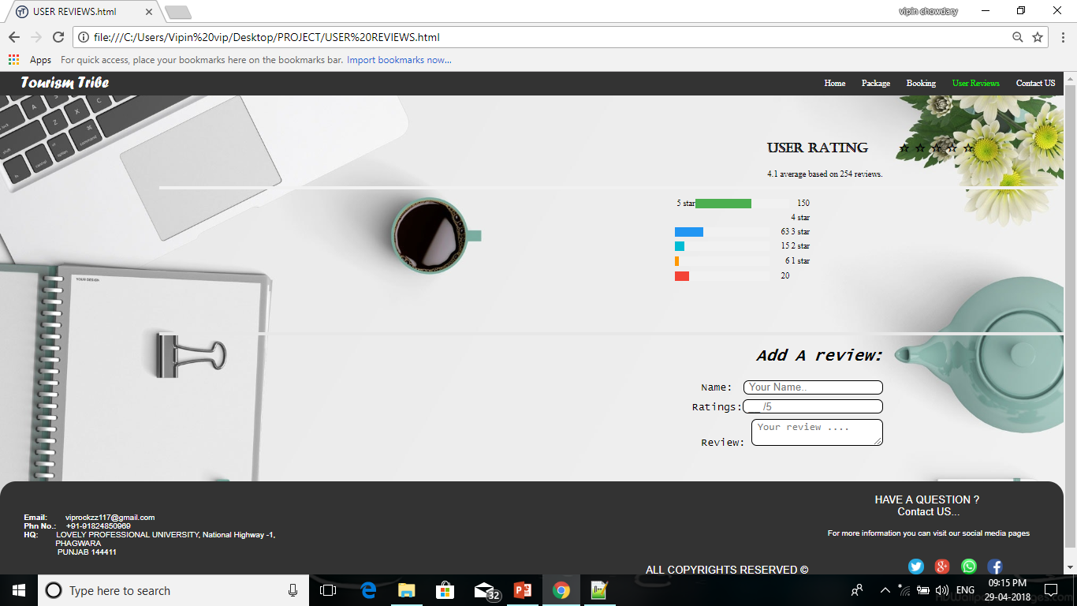
USER REVIEWS
The users who are visiting this site they can give rating for this site.
So that we can easily improve this website.
We have used HTML and CSS to have a great look.

Slide 8
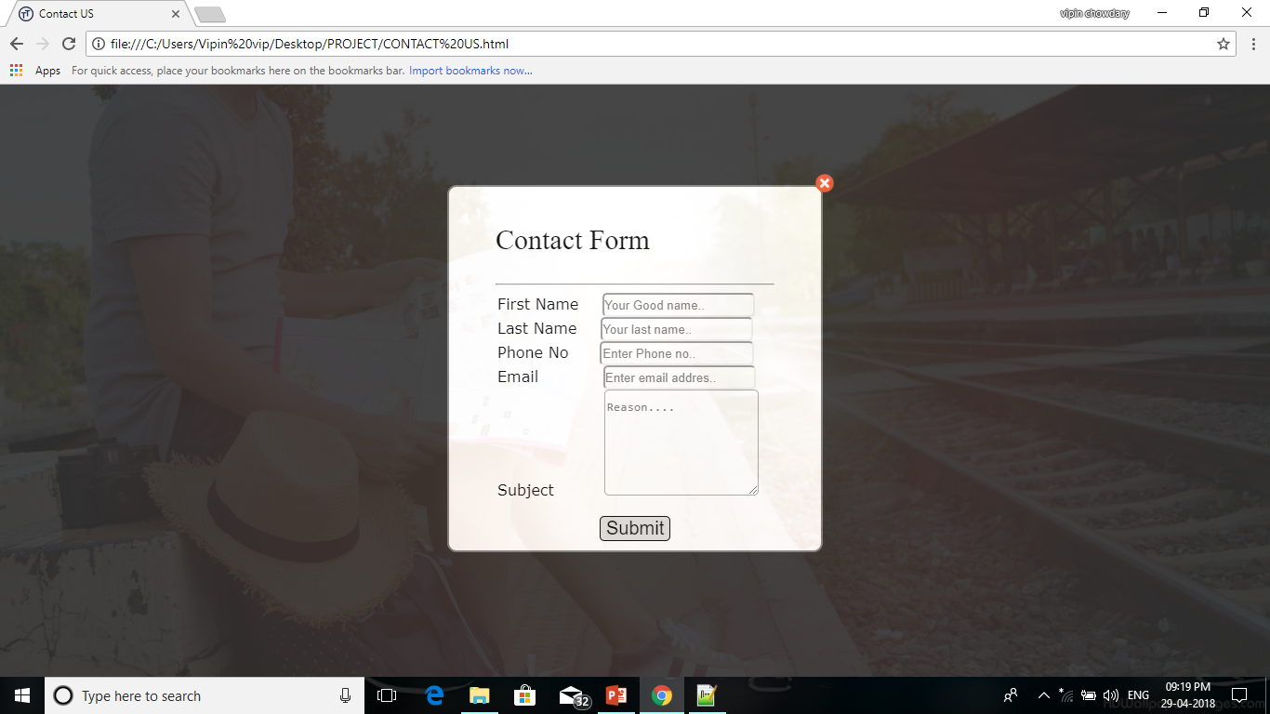
CONTACT US
With this page any body can contact us by providing their details.
We have used JAVA SCRIPT & HTML to make this page.
They have to provide full details.

Slide 9
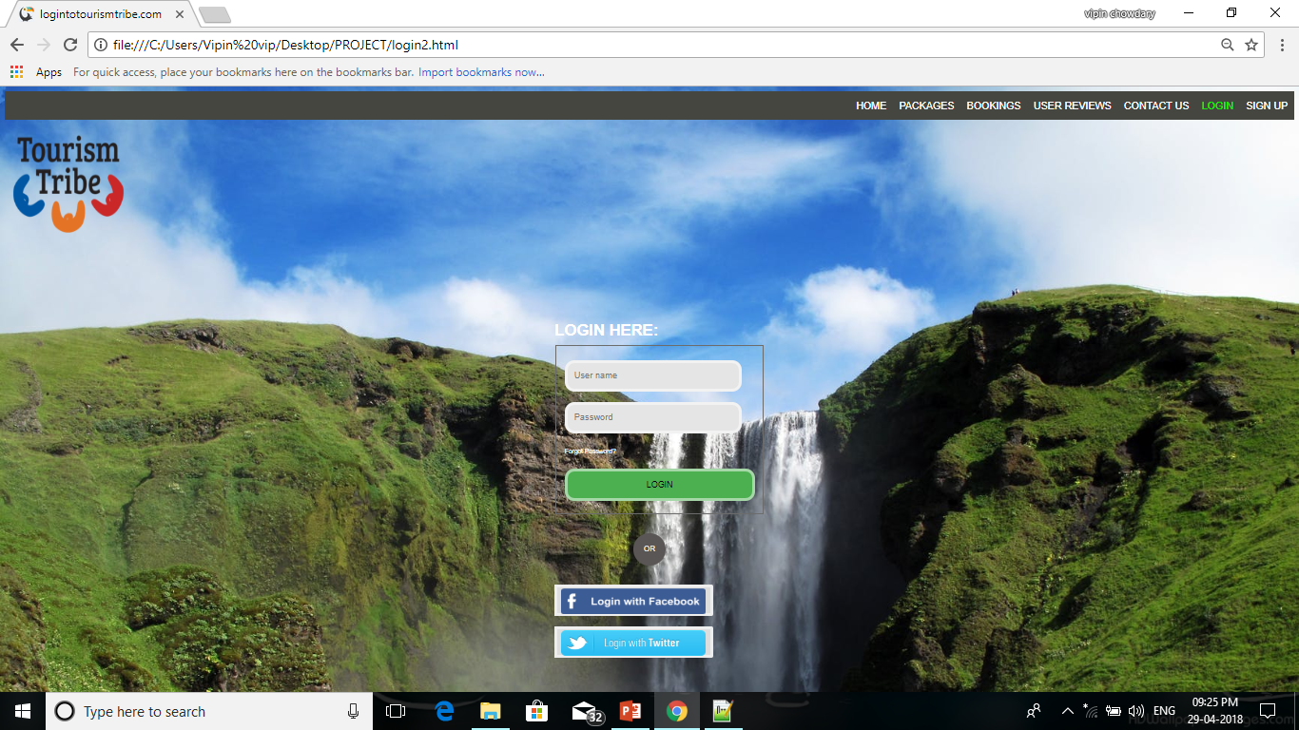
LOG-IN
In this page we provided the log-in page.
We have used JAVA SCRIPT,CSS & HTML for making this page.
We have given a good looking for page and extra links to log-in.

Slide 10
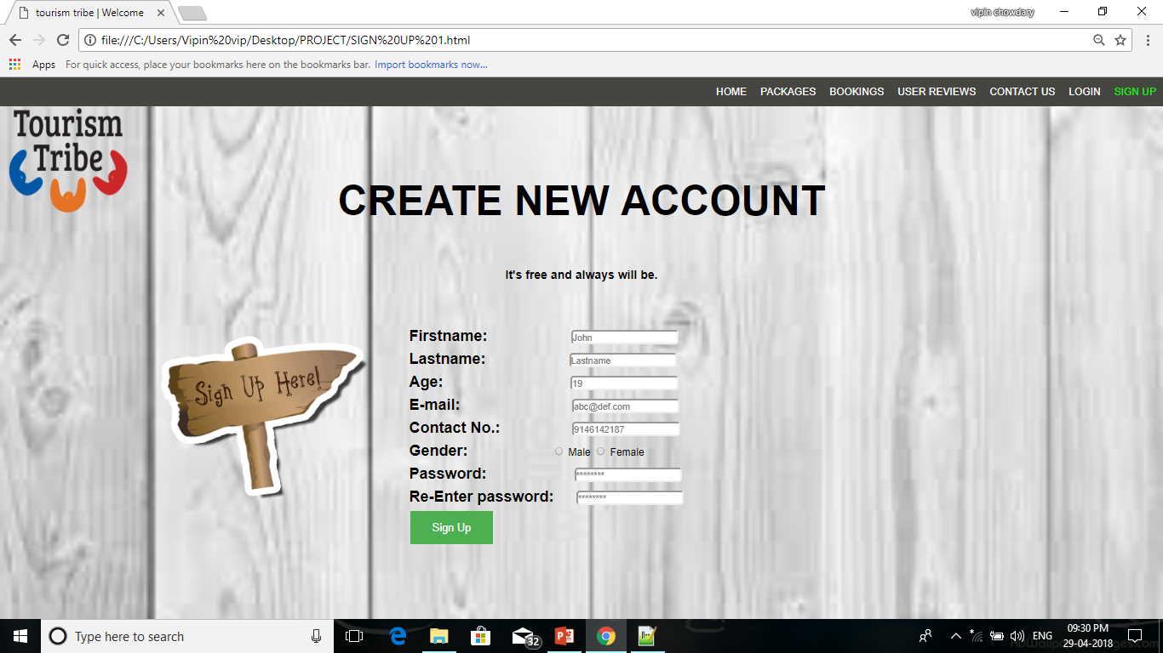
SIGN-UP
To register in this website we provided sign up form.
In this also we have used JAVASCRIPT,CSS & HTML to have a great looking for the page.
We have to fill all the details correctly.

Slide 11
CONCLUSION
From now onwards it is very easy to go for tours.
They can easy to book for tours.
We this website provided every thing for tourists.

Slide 12
THANK YOU

